Slide 1



HR Analysis
| Group 4 |
Group Members:
Rohit Dangat
Pragati Mhapsekar
Vaishnavi Jambhulkar
Vaishnavi Milind Nimkar
Md Mahmood Uddin
Vishal Jaiswal
Akash Gupta

Slide 2


C ONT E NT S
KPI-1 : Average Attrition rate for all Departments
KPI-2 : Average Hourly rate of Male Research Scientist
KPI-3 : Attrition rate Vs Monthly income stats
KPI-4 : Average working years for each Department
KPI-5 : Job Role Vs Work life balance

Slide 3
INTRODUCTION
HR Analytics, also known as People Analytics or Workforce Analytics, is the practice of collecting, analyzing, and interpreting data related to human resources in order to improve organizational decision-making and performance. It involves leveraging statistical methods, algorithms, and software tools to transform HR data into meaningful insights. By applying analytics to HR data, organizations can make informed decisions that enhance employee experience, optimize talent management, and align HR strategies with business goals.
The project aim to analyze the Human Resource dataset of Employee through a report to et insights from it by using different software tools such as SQL, Excel, Power BI, tableau.
We used for analyzing, cleaning and removing duplicates from datasets and prepared dashboard and insights accurate business decisions are made.

Slide 4
DATA S E T
Data Set | Hr_1 | Hr_2
No. of Rows | 50k | 50k
No. of Columns | 18 | 18
File Format | .xlsx | .xlsx
Dataset type | Excel Data | Excel Data

Slide 5
Tools Used In the Project
Excel
MySQL
Tableau
Power- B I
Data Exploration
Retrieving
Relevant Data according to KPIs
Joining multiple Files
Visualization
Data Exploration
Data Cleaning
Visualization
Joining multiple Files
Data Exploration
Data Cleaning in Power Query
Visualization

Slide 6





DATA ANALY S IS P ROC E S S
Step 1
Define the Question
Step 2
Collect the data
Step 3
Clean the data
Step 4
Analyze the data
Step 5
Visualize and Share the Insights

Slide 7


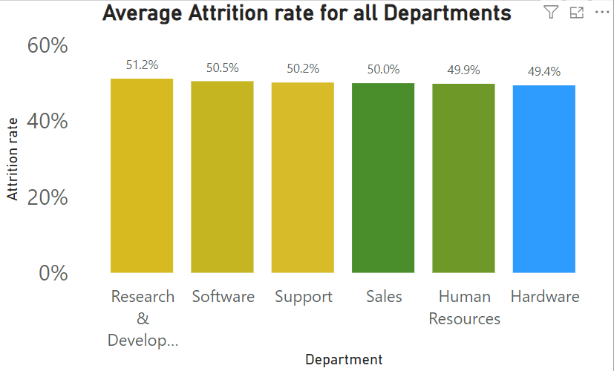
KPI -1 : Average Attrition rate for all Departments
Research & Development has the highest attrition rate (51.21%), indicating potential retention challenges.
Software, Sales, and Support departments show moderate attrition rates, necessitating retention strategies to maintain stability
Lower attrition rates in Hardware suggest relatively stable workforce dynamics, requiring maintenance rather than urgent intervention. Overall, analyzing the average attrition rate by department provides valuable insights into employee turnover dynamics within the organization, enabling informed decision-making and targeted interventions to enhance employee retention and organizational performance.
Year wise loan Amount
2011
$261 M
2010
$122 M
2009
$46 M
2008
$14 M
2007
$2 M

Slide 8
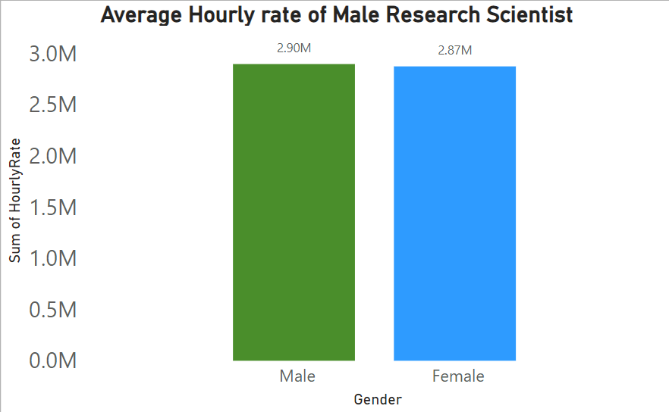
KPI- 2 : Average Hourly rate of Male Research Scientist
The average hourly rate of $114.44 for male research scientists suggests a competitive compensation structure within the HR analytics project.
This KPI may reflect the organization's investment in attracting and retaining skilled professionals in critical roles.
Continuously monitoring and adjusting this rate can help maintain employee satisfaction, promote talent retention, and support the organization's strategic objectives in HR analytics.
A4
$35.30 M
A3
$19.54 M
$34.56 M
A2
$14.0 M
A1
B5
$37.86 M
B4
$35.41 M
B
B3
$39.72 M
B2
$26.48 M
B1
$21.84 M
C5
$16.02 M
C4
$16.87 M
C
C3
$20.53 M
C2
$27.32 M
C1
$29.38 M
D5
$13.25 M
D4
$13.74 M
D
D3
$16.79 M
D2
$18.57 M
D1
$12.13 M
E5
$7.67 M
E4
$7.99 M
E
E3
$9.04 M
E2
$10.24 M
E1
$11.13 M
F5
$2.19 M
F4
$2.55 M
F
F3
$3.18 M
F2
$4.53 M
F1
$5.84 M
G5
$.70 M
G4
$1.39 M
G
G3
$.83 M
G2
$1.73 M
G1
$1.81 M

Slide 9
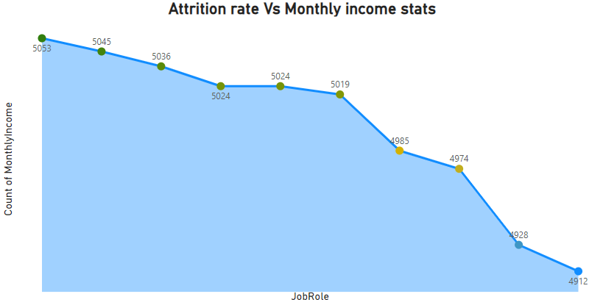
KPI-3 : Attrition rate Vs Monthly income stats
This KPI juxtaposes the attrition rate, indicating the percentage of employees leaving the organization over a specific period, with monthly income statistics, representing the average or median monthly earnings of employees. By comparing these metrics, organizations can assess the correlation between employee turnover and compensation levels. It helps in understanding whether compensation plays a significant role in employee retention and provides insights into potential areas for improvement in compensation strategies to enhance employee satisfaction and reduce turnover.

Slide 10
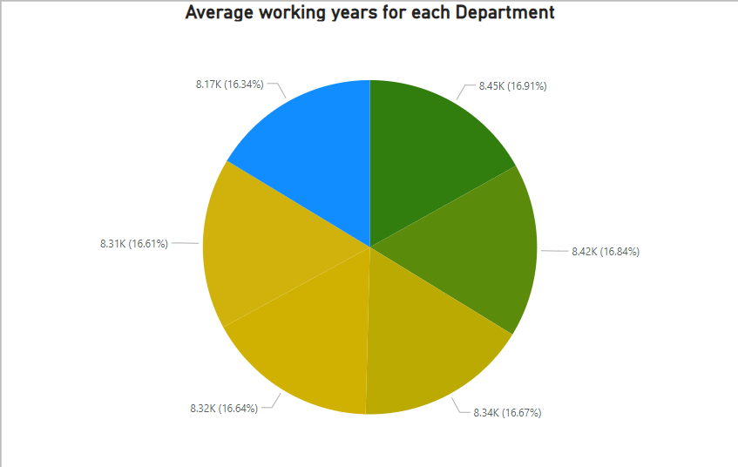
KPI- 4 : Average working years for each Department
This KPI calculates the average number of years employees have worked within each department of an organization. It helps identify departments with high turnover rates or low employee tenure, enabling HR and management to implement targeted retention strategies or address potential issues impacting employee satisfaction and longevity. Additionally, it offers insights into the effectiveness of leadership, work culture, and career development opportunities within each department. Tracking this metric over time allows for the evaluation of the success of retention initiatives and overall organizational health.
Month wise loan status
$45.0 M
Charged Off
Current
Fully Paid
$40.0 M
$35.0 M
$30.0 M
$25.0 M
$20.0 M
$15.0 M
$10.0 M
$5.0 M
$.0 M
Jan Feb Mar Apr May Jun
Jul
Aug Sep Oct Nov Dec
State wise loan status
$90 M
Fully Paid
Current
Charged Off
$80 M
$70 M
$60 M
$50 M
$40 M
$30 M
$20 M
$10 M
$ M
CA
NY TX FL NJ IL VA PA GA MA OH MD AZ WA CO NC CT MI MO MN NV WI SC AL OR LA KY OK KS UT DC AR NH NM WV RI HI DE AK WY MT SD VT TN MS IN ID IA NE ME

Slide 11
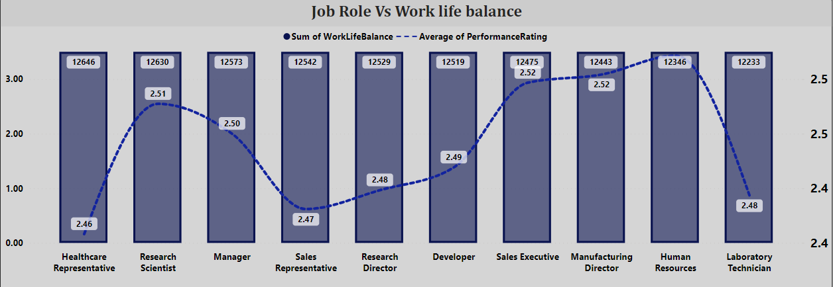
KPI - 5 : Job Role Vs Work life balance
This KPI measures the balance between job roles and employees' ability to maintain a healthy work-life balance. It assesses factors such as workload, job demands, flexibility in work hours, and employee satisfaction with their ability to manage work and personal life effectively. A positive balance indicates that employees feel supported in managing their professional responsibilities while also enjoying personal time and fulfilling non-work obligations. Monitoring this KPI helps organizations identify areas where adjustments may be needed to promote employee well-being and reduce burnout, ultimately leading to higher job satisfaction and retention rates.

Slide 12

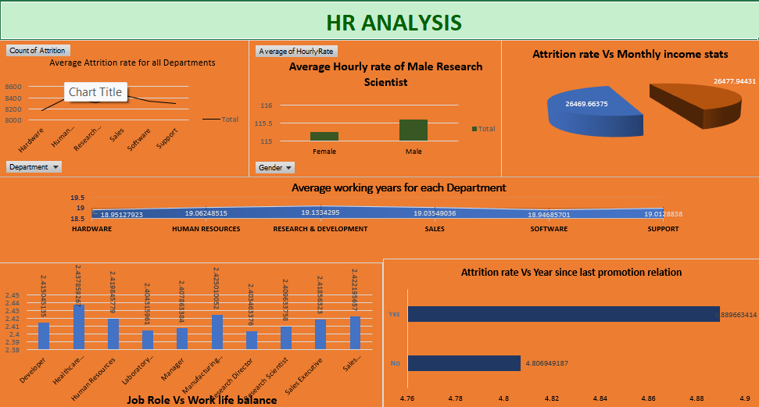
E XCE L DAS HB OAR D

Slide 13

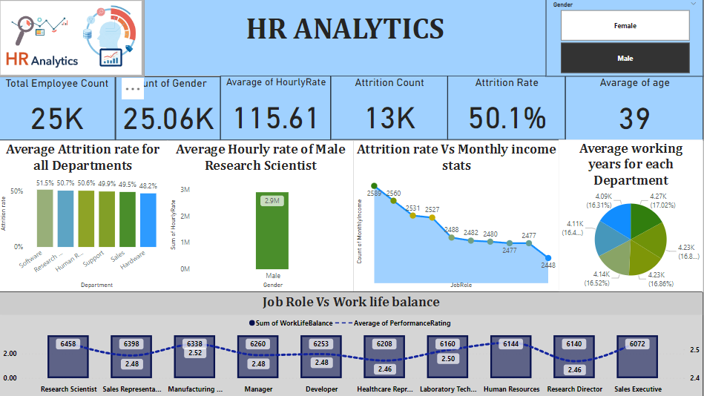
P OW E R B I DAS H B OAR D

Slide 14
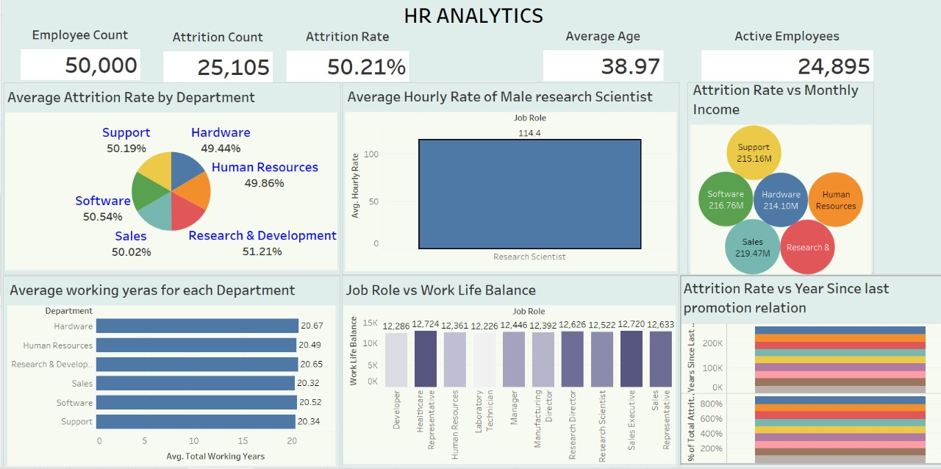
TAB L E AU DAS H B OAR D

Slide 15
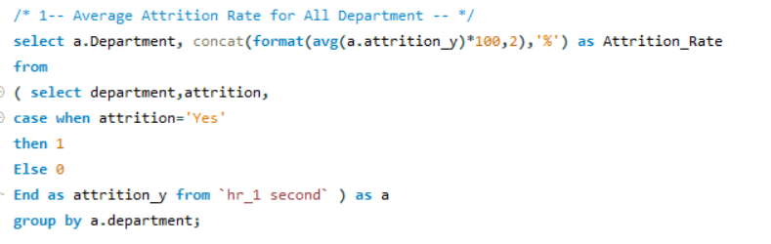
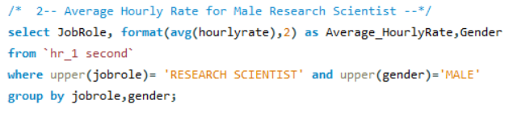
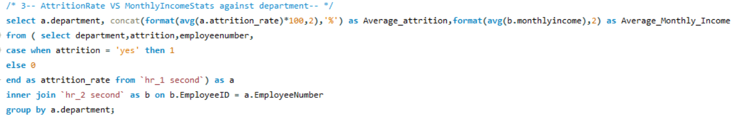
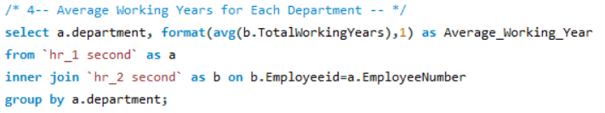
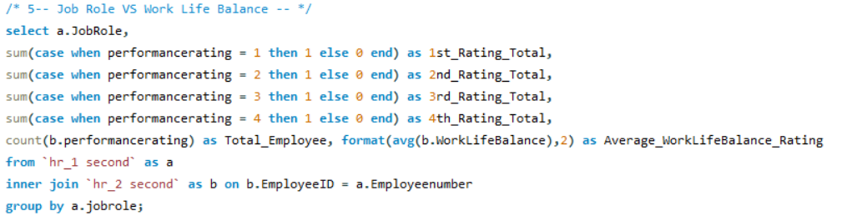
SQL QUERIES

Slide 16

CONCLUSION
HR Analytics is a powerful tool that transforms data into actionable insights, enabling organizations to make informed decisions about their workforce.
By leveraging metrics such as attrition rates, time to hire, employee engagement scores, absenteeism rates, and diversity and inclusion metrics.
HR professionals can identify trends, address issues proactively, and develop strategies to enhance employee satisfaction and organizational performance. Ultimately, HR Analytics helps create a more efficient, productive, and engaged workforce, aligning HR practices with business goals and driving overall success.
This strategic approach enhances employee satisfaction and aligns HR practices with overall business objectives, driving organizational success.

Slide 17
Recommendation
Define Clear Objectives: Clearly define the objectives and goals of HR analytics initiatives. Align these objectives with broader organizational strategies to ensure relevance and impact.
Focus on Data Quality: Prioritize data quality assurance measures to ensure the accuracy, completeness, and reliability of HR data. Establish data governance policies and procedures to maintain data integrity.
Develop Analytical Skills: Invest in training and development programs to enhance the analytical capabilities of HR professionals. Provide opportunities for learning data analysis techniques and tools relevant to HR analytics.
Utilize Predictive Analytics: Leverage predictive analytics to anticipate future workforce trends and identify potential risks and opportunities. Develop predictive models to forecast attrition, employee performance, and talent needs.
Promote Data-Driven Culture: Foster a culture that values data-driven decision-making across the organization. Encourage HR and business leaders to base their decisions on empirical evidence and insights derived from HR analytics.
.

Slide 18


TH ANK YO U

